Slide 1
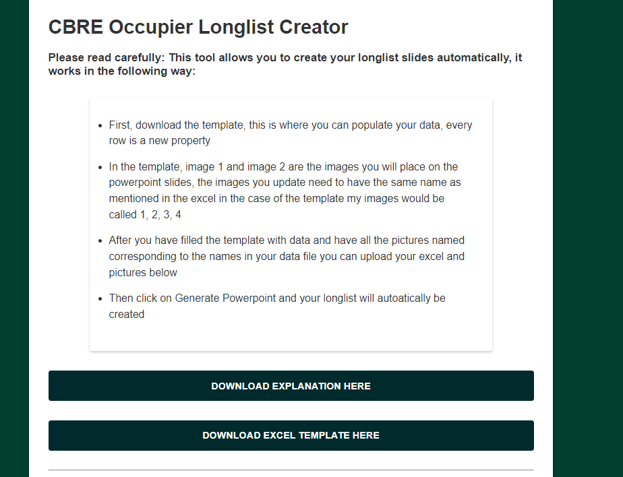
Step 1: Download the template

Slide 2
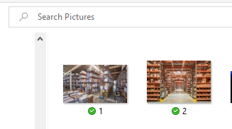
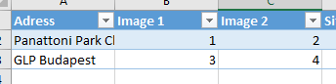
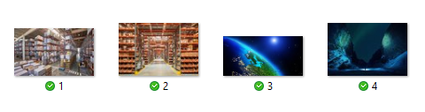
Step 2: Fill the template with property data
Step 3: Collect your images and give them the same name as in the excel file
If my images are called 1 and 2 in the folder, this should also be the case in the excel
In this example my pictures for the second slide (GLP Budapest) need to be called 3 and 4

Slide 3
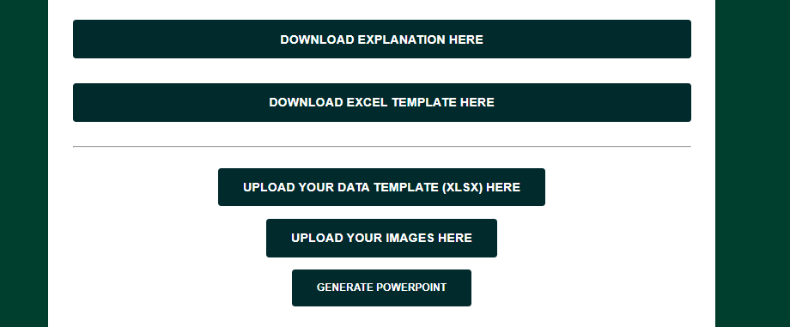
Step 4: Upload the excel file

Slide 4
Step 4: Upload your images

Slide 5
Step 6: Click on Generate PowerPoint

Slide 6
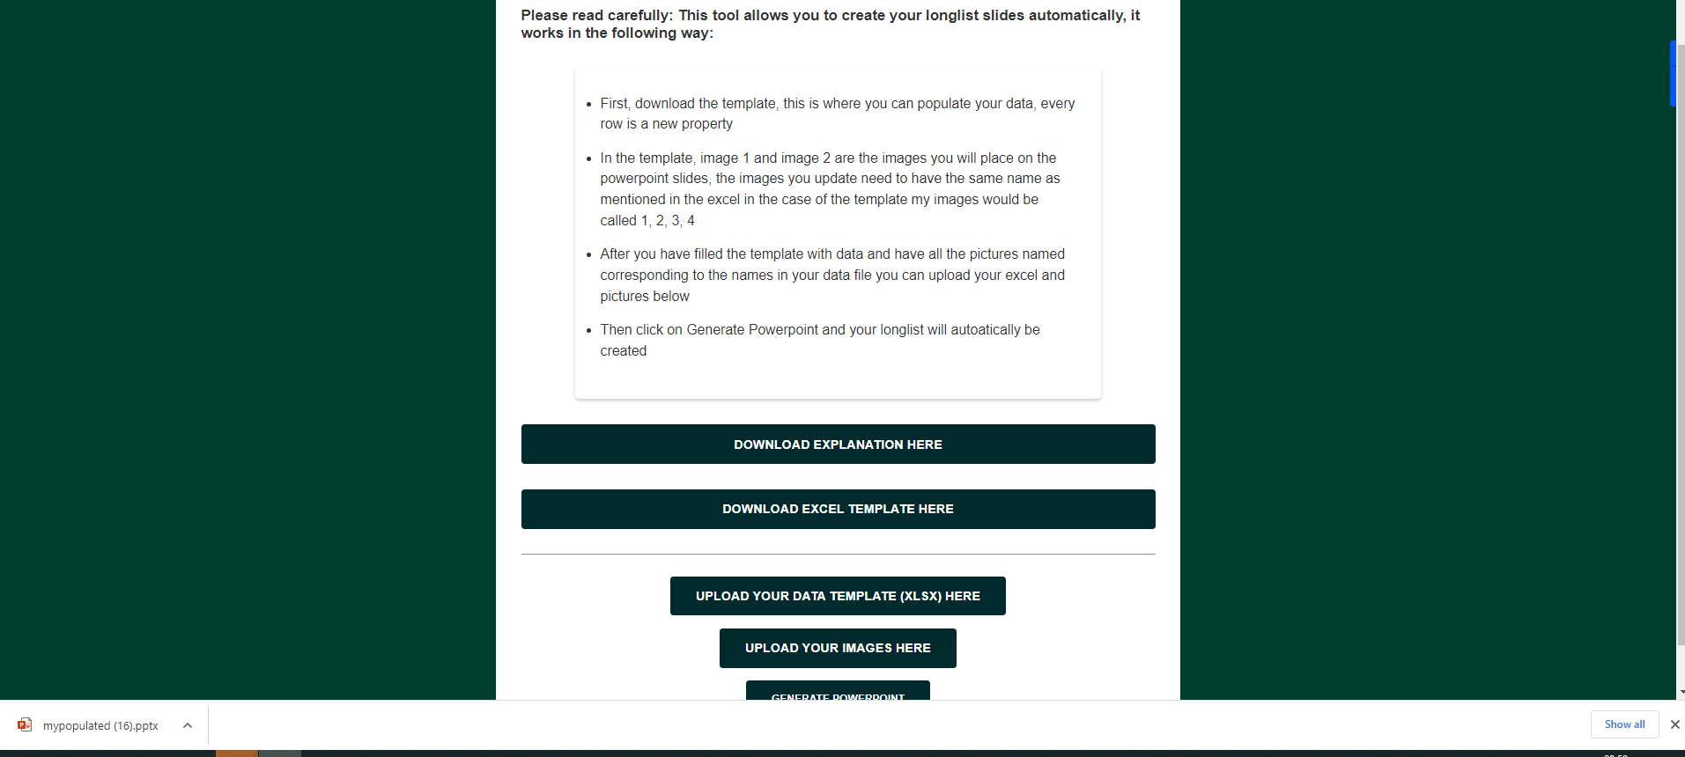
Step 7: Download your longlist

Slide 7
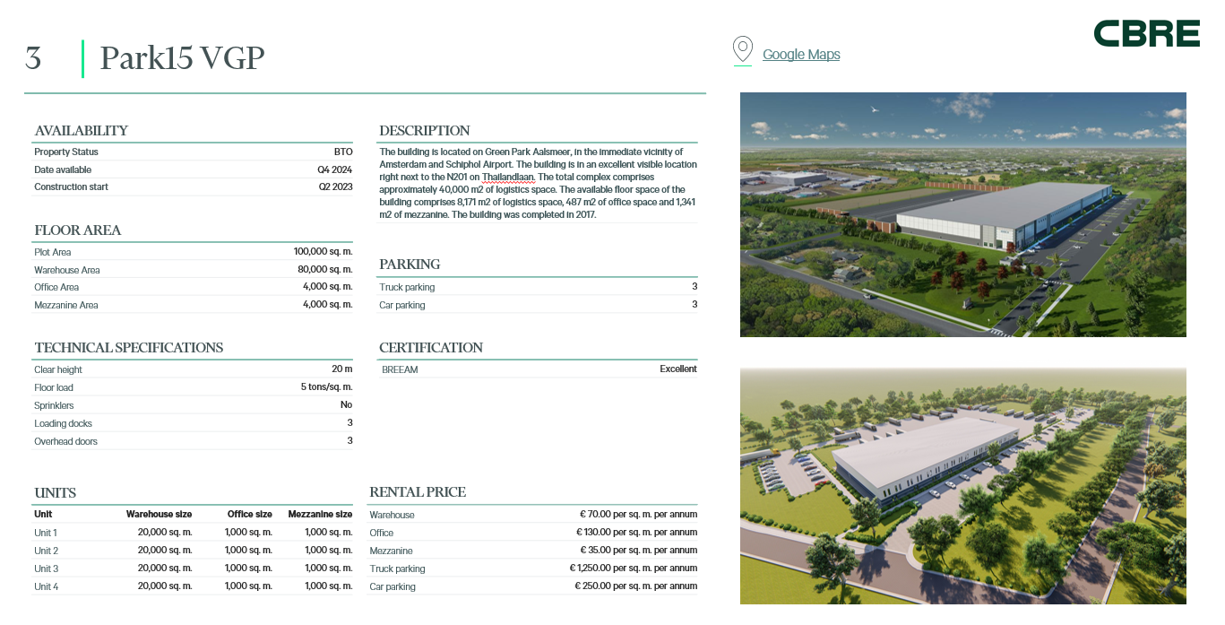
Step 8: Your longlist is filled and ready to be used

